Slide 1
Reproducible Workflows with R and Markdown
Scott Claessens
2020.07.24

Slide 2
Outline
What is reproducibility?
Why is reproducibility important?
A reproducible workflow with R and Markdown

Slide 3
Outline
What is reproducibility?
Why is reproducibility important?
A reproducible workflow with R and Markdown

Slide 4
What is reproducibility?
“Reproducibility refers to the ability of a researcher to duplicate the results of a prior study using the same materials as were used by the original investigator. That is, a second researcher might use the same raw data to build the same analysis files and implement the same statistical analysis in an attempt to yield the same results….”
K. Bollen, J. T. Cacioppo, R. Kaplan, J. Krosnick, J. L. Olds, Social, Behavioral, and Economic Sciences Perspectives on Robust and Reliable Science (National Science Foundation, Arlington, VA, 2015).

Slide 5
Outline
What is reproducibility?
Why is reproducibility important?
A reproducible workflow with R and Markdown

Slide 6
Outline
What is reproducibility?
Why is reproducibility important?
A reproducible workflow with R and Markdown

Slide 7
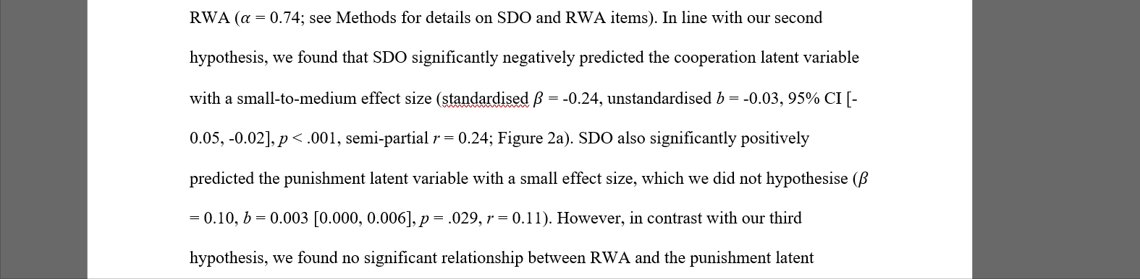
Why is reproducibility important?

Slide 8
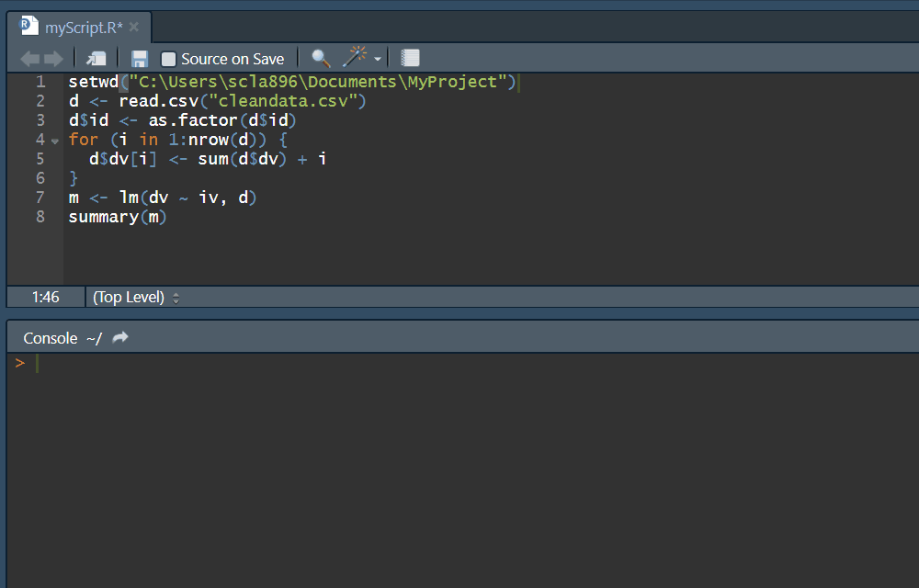
Why is reproducibility important?

Slide 9
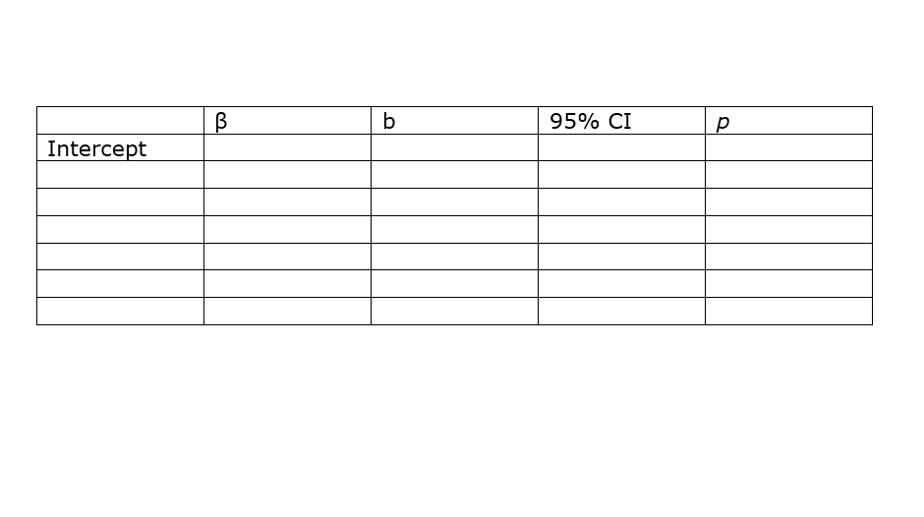
Why is reproducibility important?

Slide 10
Outline
What is reproducibility?
Why is reproducibility important?
A reproducible workflow with R and Markdown

Slide 11
Outline
What is reproducibility?
Why is reproducibility important?
A reproducible workflow with R and Markdown

Slide 12
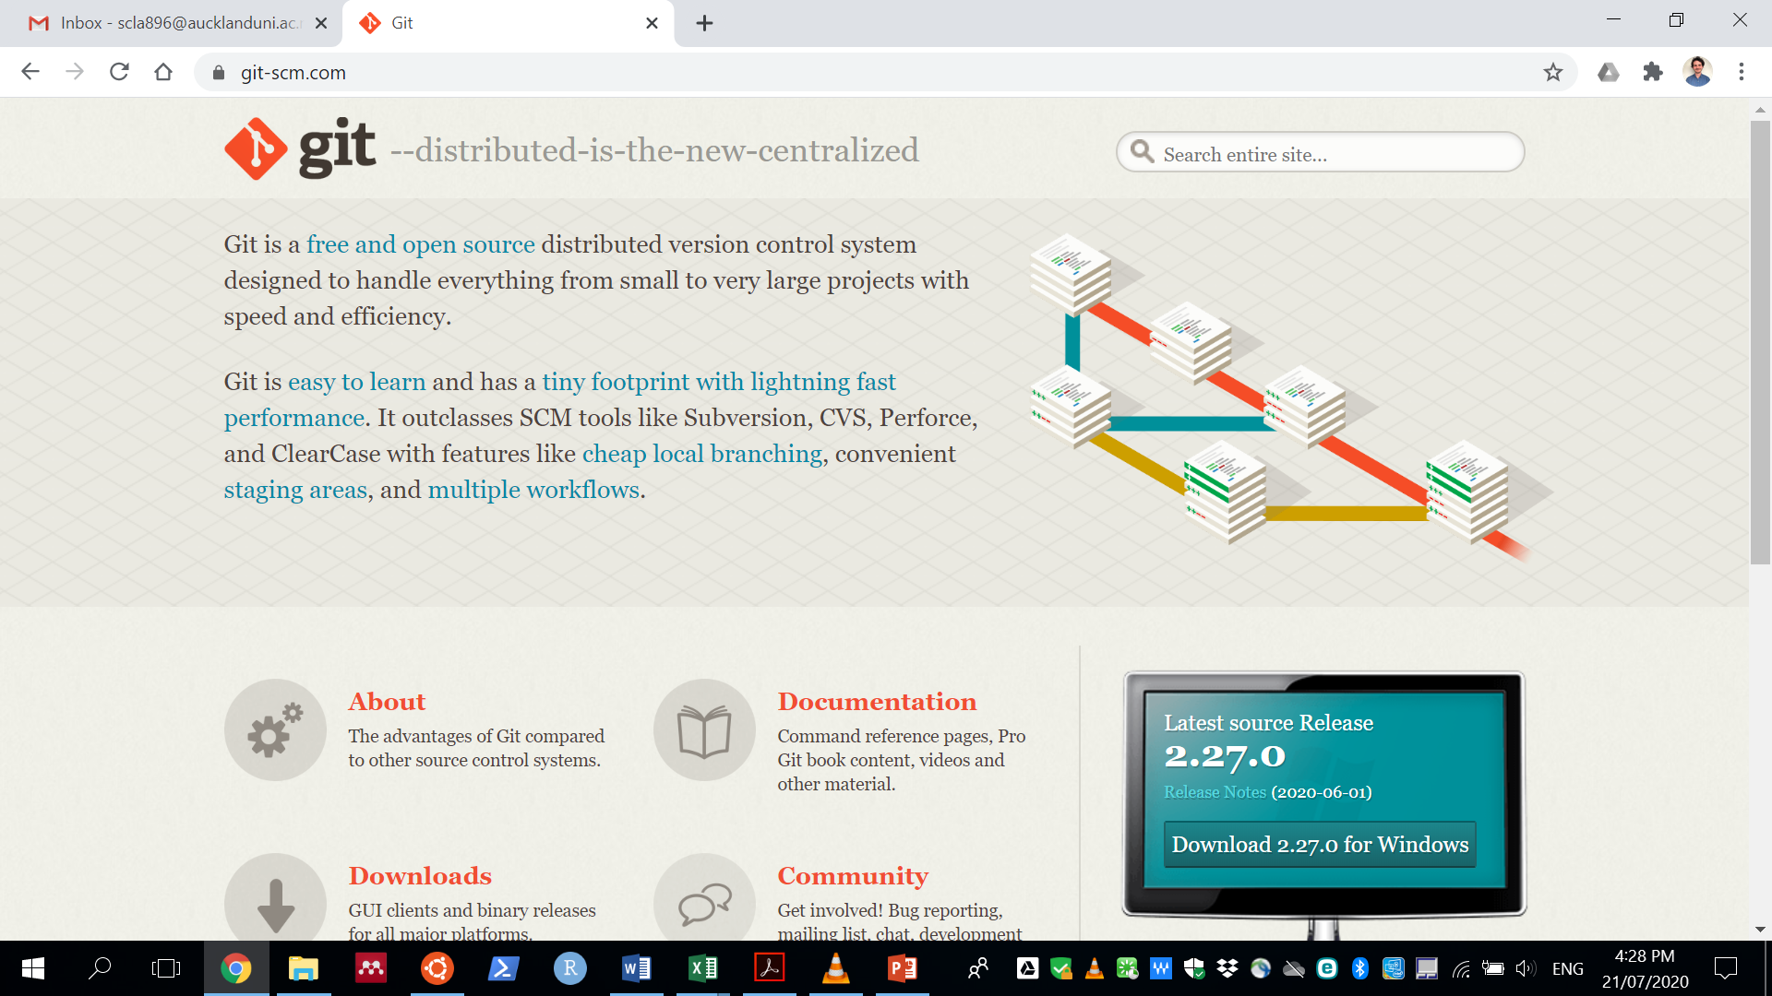
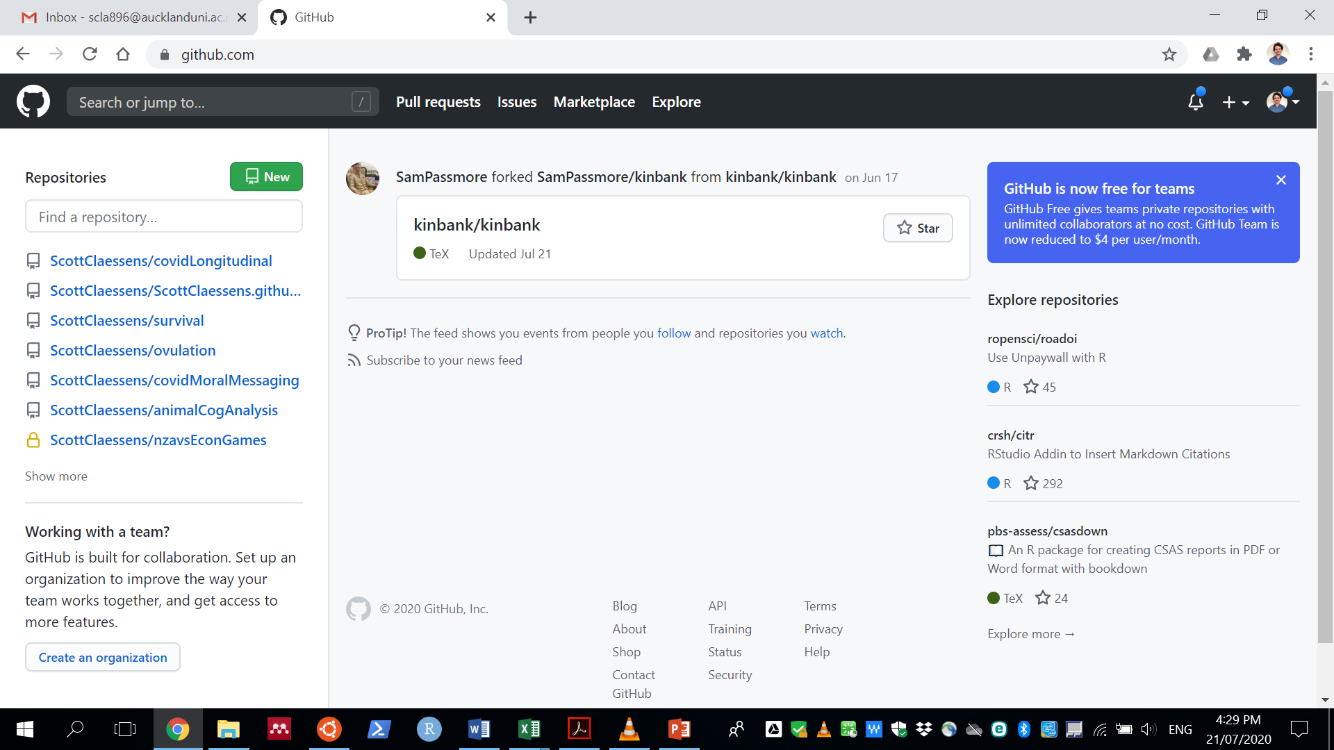
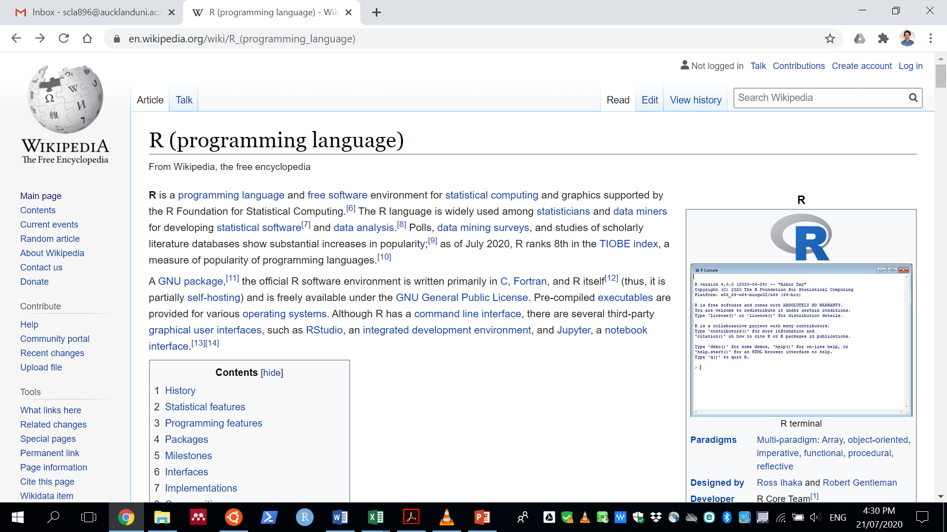
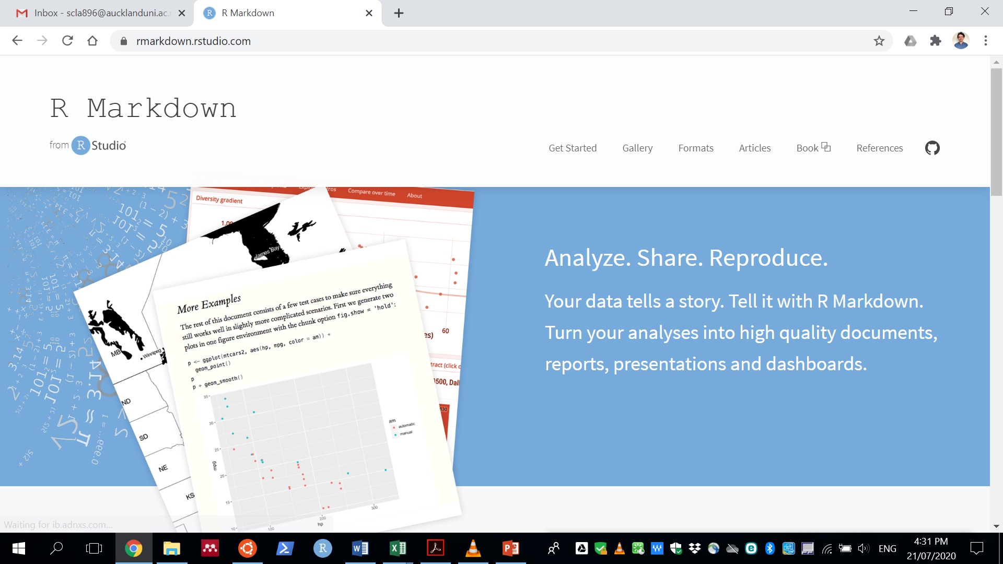
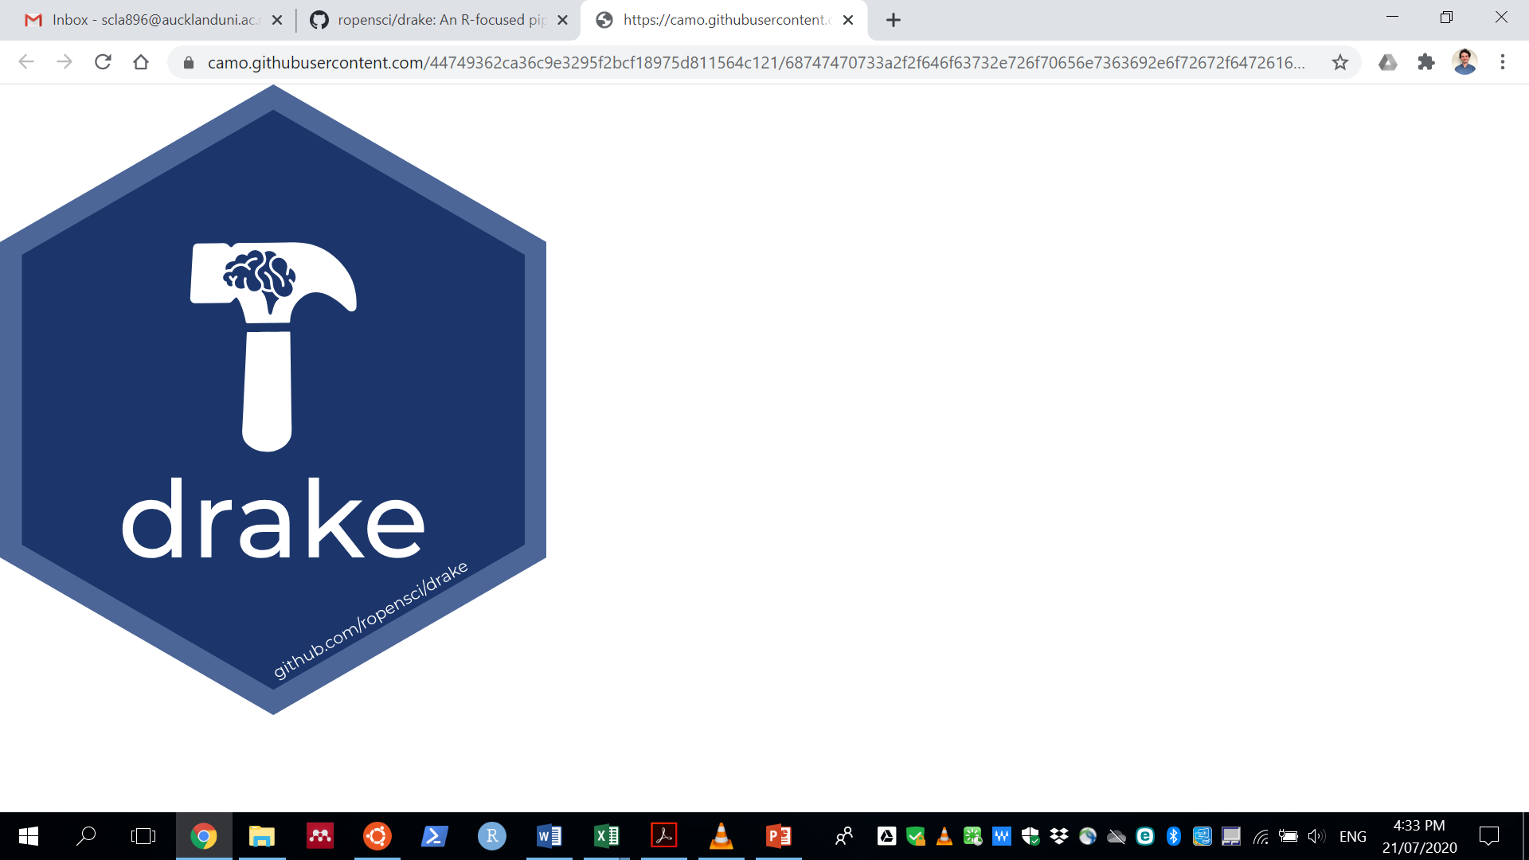
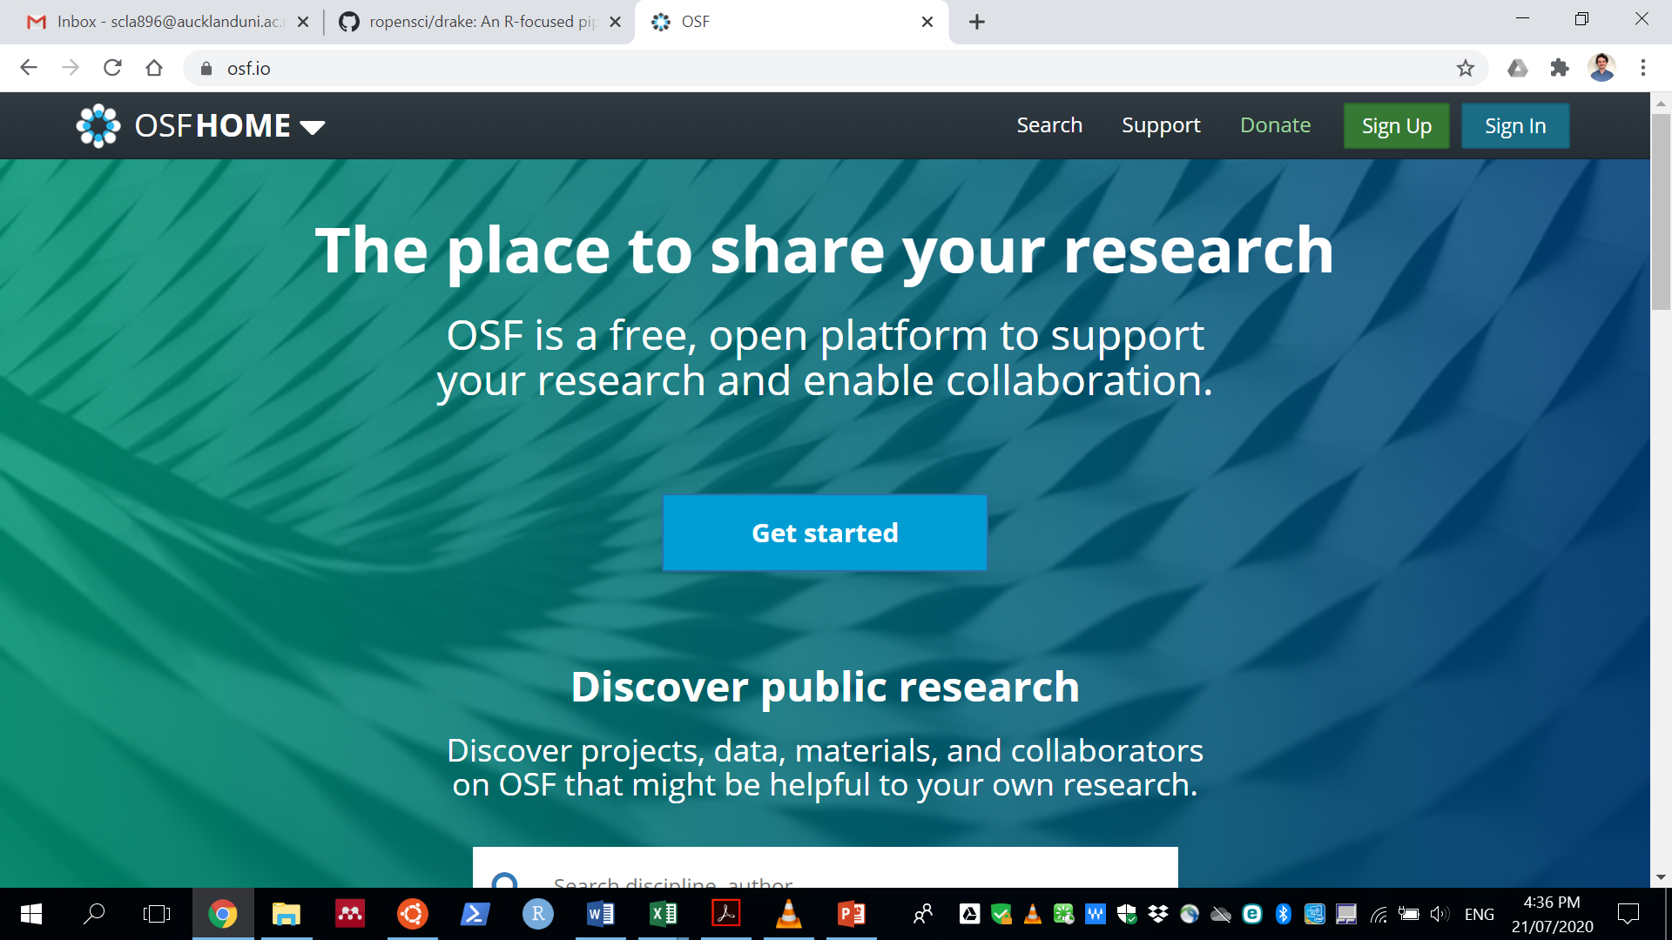
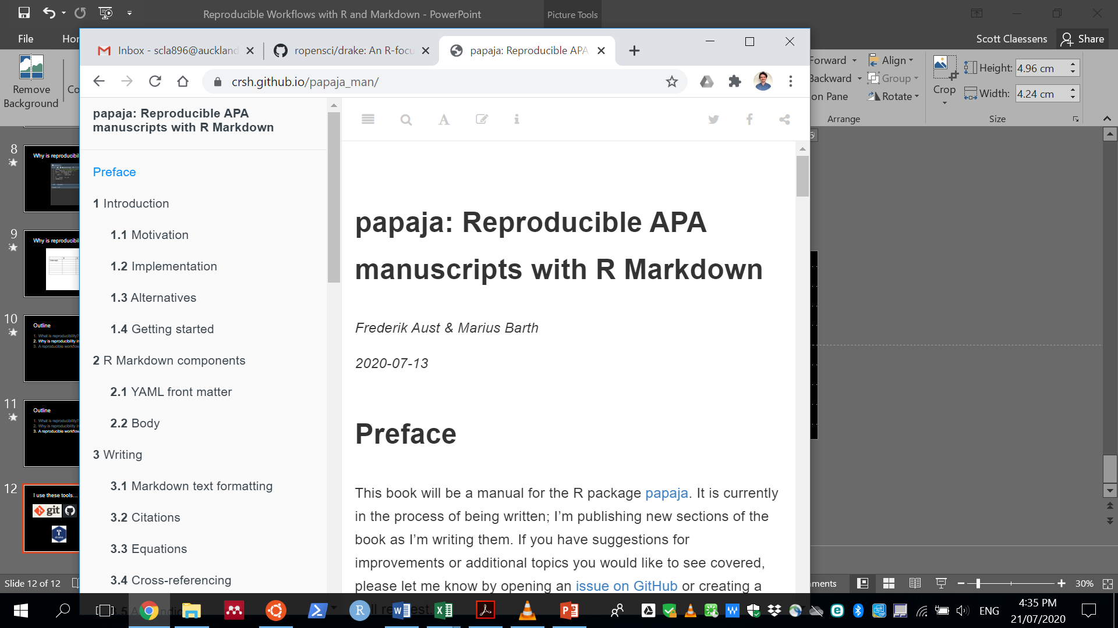
I use these tools…

Slide 13
The workflow
Pre-register hypotheses on OSF

Slide 14
The workflow
Pre-register hypotheses on OSF
Create project directory

Slide 15
The workflow
Pre-register hypotheses on OSF
Create project directory
Run study

Slide 16
The workflow
Pre-register hypotheses on OSF
Create project directory
Run study
Copy untampered raw data into project directory

Slide 17
The workflow
Pre-register hypotheses on OSF
Create project directory
Run study
Copy untampered raw data into project directory
Clean, analyse, and plot these data in R using drake

Slide 18
The workflow
Pre-register hypotheses on OSF
Create project directory
Run study
Copy untampered raw data into project directory
Clean, analyse, and plot these data in R using drake
Write manuscript using papaja and R Markdown

Slide 19
The workflow
Pre-register hypotheses on OSF
Create project directory
Run study
Copy untampered raw data into project directory
Clean, analyse, and plot these data in R using drake
Write manuscript using papaja and R Markdown
Commit changes to a git repository and upload to OSF

